Slide 2

Unit 7: Managing and Customizing
Interactive Grids

Slide 3
Lesson Objectives
After completing this lesson, you should be able to:
Manage interactive grid attributes
Control Interactive Grid Pagination
Customize the Interactive Grid Toolbar
Enable Users to Save Public Interactive Grids
Customize interactive grid as an end user
Notes:
This lesson is divided in to two parts: Part 1 and Part 2. In part 1, you learn how to customize an interactive grid as a developer. Part 2 deals with how to use and customize an interactive grid as an end user.

Slide 4

Part 1: Customizing an Interactive Grid as a Developer
Notes:
By default, an interactive grid includes a search bar, an Actions menu, and a Column Heading menu. Users can use these controls to alter the layout of report data by selecting columns, applying filters, highlighting, and sorting. Developers can customize an interactive grid in Page Designer and configure how these controls display. Developers can determine whether an interactive grid is editable or read-only, set the pagination, create column groups, and can alter the source query of an interactive grid. In Part 1, you learn how to customize an interactive grid (as a developer) for your end users.

Slide 5
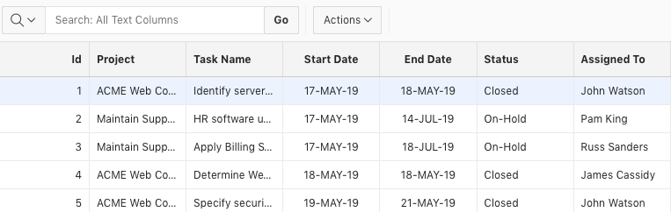
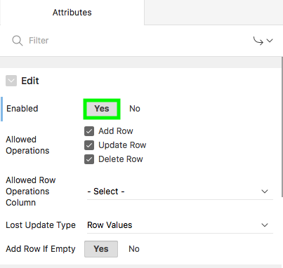
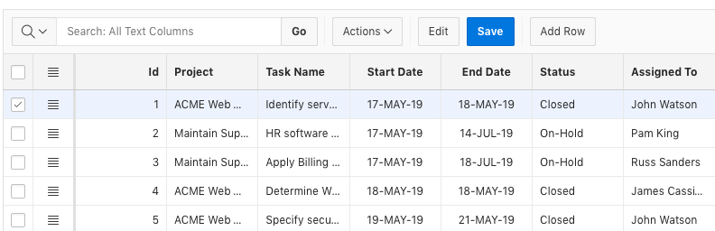
Making an Interactive Grid Editable
Read-only Interactive Grid
Editable Interactive Grid
Notes:
As a developer, you can determine whether the underlying data is read-only or editable by your end users. The slide example shows converting a read-only interactive grid in to an editable interactive grid by modifying the interactive grid attributes.
Interactive grid attributes control how an interactive grid works. Developers use these attributes to:
Determine if end users can edit the underlying data
Configure report pagination
Create error messages
Configure the toolbar and download options
Control if and how users can save an interactive grid
Add Icon and Detail Views to the toolbar.
You can convert an already existing read-only interactive grid to an editable interactive grid by performing these steps:
View the page in Page Designer. Page Designer appears.
In the Rendering tab, locate the region containing the interactive grid.
Under the region, select the Attributes node. The Property Editor displays the attributes.
Expand Edit and select Yes for Enabled. When an interactive grid is editable, the system automatically creates a process to process the records. When Enabled is set to Yes, additional options appear. Note that you can configure data manipulation operations: Add Row, Update Row, and Delete Row.
Click Save and Run Page. Now you see that the read-only interactive grid is converted to an editable interactive grid.
When an interactive grid is editable, end users can edit the underlying data, add rows, delete rows, and refresh rows. Instead of creating a read-only interactive grid first, and then converting it in to an editable interactive grid, Application Express allows you to directly create an editable interactive grid by using one of the following options:
Create Application Wizard: Click the Add Page button, select the Interactive Grid page type and accept the default – Allow Editing.
Create Page Wizard: Select Form for Page Type and then select Editable Interactive Grid

Slide 6
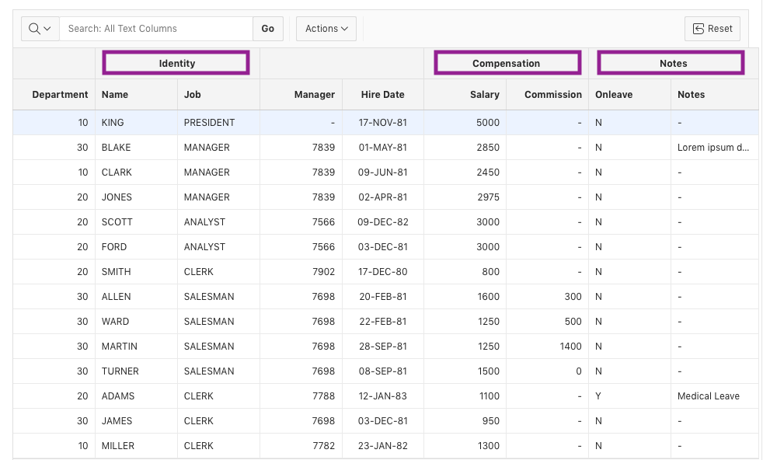
Adding Column Group Headers
Column groups defined: Identity, Compensation, Notes
Notes:
Application Express allows you to define and use column groups in interactive grids. You can choose to use column groups for just report headings, just for single row view or both. You use column group headings to reorder columns just like column headings. The slide example shows three column groups: Identity, Compensation, and Notes.
Note: Interactive Reports allow defining column groups but they are only used in single row view.

Slide 7
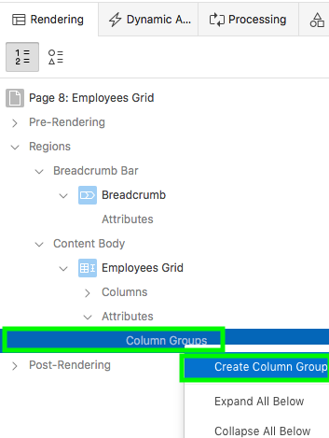
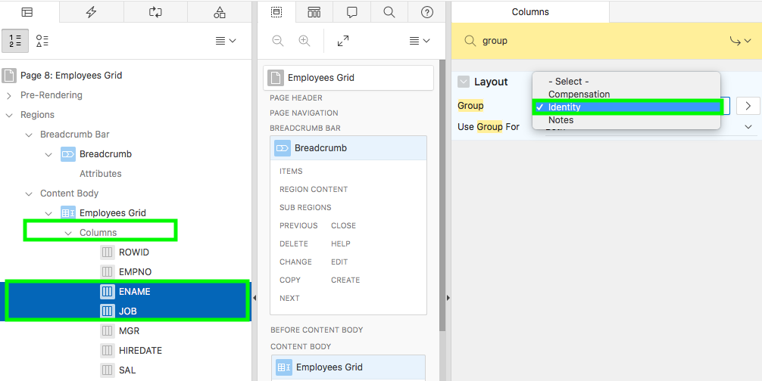
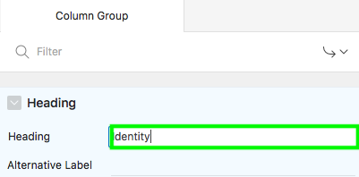
Adding Column Group Headers: Example and Steps
Assigning column groups to columns
Notes:
To define and use column group headers, perform the following steps:
Open your interactive grid page in Page Designer
In the Rendering tab, locate the region containing the interactive grid.
Under the region, expand the Attributes node.
Right-click Column Groups and select Create Column Group
In the Property Editor, for Heading, specify a name for your column group. Then, click Save.
Repeat steps 4 and 5 to create multiple column groups. Alternatively, right-click a column group to create a duplicate. Then, in the Property Editor, you can modify the heading and click Save
Now, you need to assign column groups to the desired columns.
Under Page Rendering, navigate to the interactive grid region and expand Columns.
Select a column for which you want to assign a column group. I
In the Property Editor, enter Group in the Filter Properties field and press <Enter>. Alternatively, in the Property Editor, expand Layout.
For Group, select a column group of your choice and click Save. In the slide example, you select multiple columns and assign the Identity column group.
Click Save and Run Page to see that the columns appear under their corresponding column group headers.

Slide 8
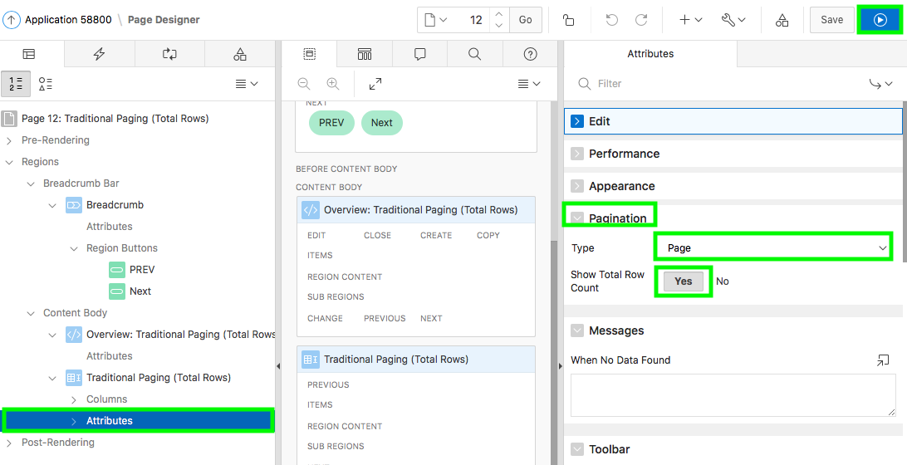
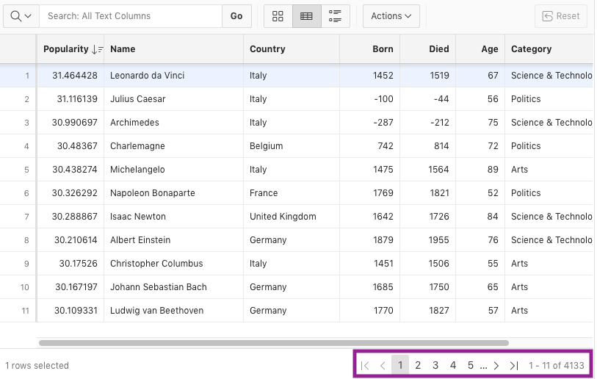
Controlling Interactive Grid Pagination: Example 1
Notes:
Often not all report rows are displayed in a report. In order to display additional rows, the end user can use the pagination provided. Pagination provides the end user with information about the number of rows displayed and the current position within the result set. Interactive grids include two types of pagination:
Page: The first rows will be displayed, based on the number specified in Rows per Page. If there are additional rows, controls will be added to the report footer, allowing end users to navigate forwards and backwards between row sets.
Scroll: Initially enough rows to fill the height of the Interactive Grid are displayed. As the end user scrolls additional rows are displayed, getting more data from the server as needed.
An end user should either be paging or scrolling but not both. To change interactive grid pagination, perform the following steps:
Edit your interactive grid attributes. The Attributes display in the Property Editor.
Expand Pagination
For Type, select either Page or Scroll. If you select Page, rows display based on the number specified in Rows per Page. If there are additional rows, controls are added to the report footer which enables users to navigate forwards and backwards between row sets. If you specify Scroll, rows display to fill the height of the interactive grid. As the end user scrolls, additional rows display as needed.
For Show Total Row Count, select Yes or No. Selecting Yes displays the total row count in the report footer. Enabling this option requires an additional query which may hinder performance on very large data sets.
To save your changes click Save. To save and run the page, click Save and Run Page.
The slide example shows selecting Page for Type and Yes for Show Total Row Count. The default pagination settings in an interactive grid are Scroll for
Type and No for Show Total Row Count.
When type is Page, it results in pagination controls in the footer of the Interactive Grid. Show Total Row Count really determines if the database counts the total number of rows in the query result set. When the total number of rows is not known then only the range of rows (For example 1 - 50) and Next and Previous buttons can be shown. The Auto setting for Actions menu Rows Per Page lets the grid choose the number of rows based on the height of the grid.
You may notice that as you click Next page sometimes the progress spinner is shown indicating that data is being fetched from the server and sometimes it isn't. An important difference between Interactive Report and Interactive Grid is that the latter has distinct data (model) and view layers. This is known as model view separation. The view shows just a portion of the rows in the model and the model is responsible for getting more data from the server when needed. This is critical for editable grids and for scroll paging but always in effect even for traditional paging.

Slide 9
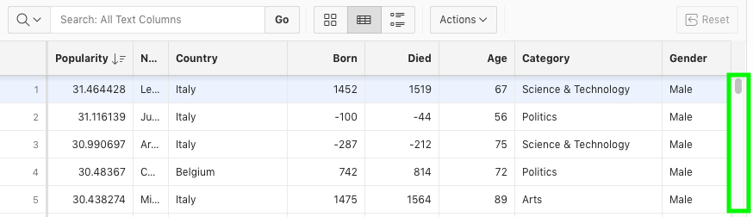
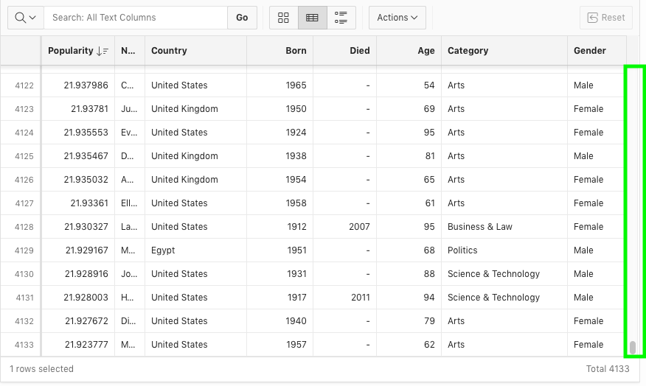
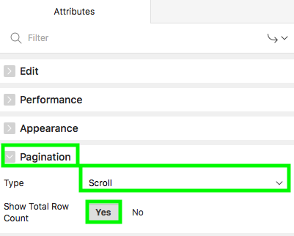
Controlling Interactive Grid Pagination: Example 2
Scroll Paging
Notes:
The slide example shows scroll paging. You select Scroll for Type and Yes for Show Total Row Count.
The region appears to contain the entire result set but rows are rendered on demand as the user scrolls. In turn the model fetches data from the server as it is needed by the view. You can even drag the scroll bar handle all the way to the bottom and then scroll up. The Interactive Grid does not need to fetch or render all the data from the start to finish of the result set. Only the data that needs to be displayed is rendered or fetched into the model. This means there can be holes in what is rendered or in the model. These holes are filled in as the user scrolls. With large data sets and scroll paging a lot of data can accumulate on the client. Most of the time this is not a problem because the user will tire of scrolling and resort to searching or filtering.
Perform the following steps:
Edit your interactive grid attributes. The Attributes display in the Property Editor.
Expand Pagination
For Type, select Scroll.
For Show Total Row Count, select Yes. Selecting Yes displays the total row count in the report footer. Enabling this option requires an additional query which may hinder performance on very large data sets.
To save your changes click Save. To save and run the page, click Save and Run Page.

Slide 10
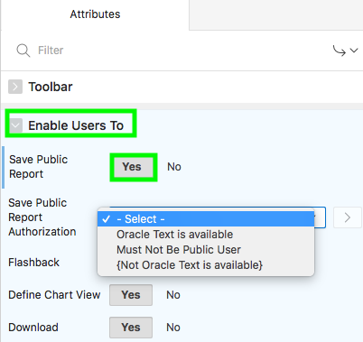
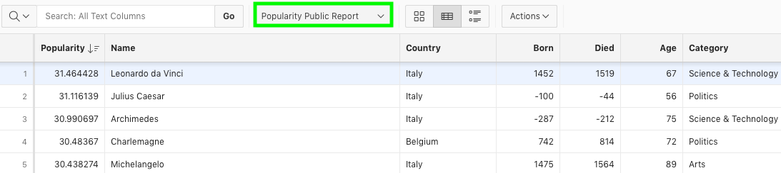
Enabling Users to Save Public Interactive Grids
End User Saves Public Report
Notes:
Developers can enable the capability for end users to save public interactive grids. Developers can also restrict who can save a public interactive grid. Public reports display on the Saved Reports list on the toolbar and are available to all users. However, only the user who creates a public interactive grid can save, rename, or delete it.
Developers can select an authorization scheme to restrict who can save public interactive grid. To enable an end user to save a public interactive grid, this authorization scheme must evaluate to TRUE for that user. If an authorization scheme is not selected, then any user may save public interactive grids. You learn more about authorization schemes later in this course.
To enable the capability for end users to save public interactive grids, perform the following steps:
Edit your interactive grid attributes. The Attributes display in the Property Editor.
Expand Enable Users To
Select Yes for Save Public Report
Click Save. Then, click Save and Run Page. Now, any end user can save public interactive grids.
Now, to restrict end users who can save public interactive grid, perform the steps 1 through 3 above and then:
For Save Public Report Authorization, select an authorization scheme. To enable an end user to save a public interactive grid, this authorization scheme must evaluate to TRUE for that user. If an authorization scheme is not selected, then any user may save Public interactive grids.
Click Save. Then, click Save and Run Page.

Slide 11
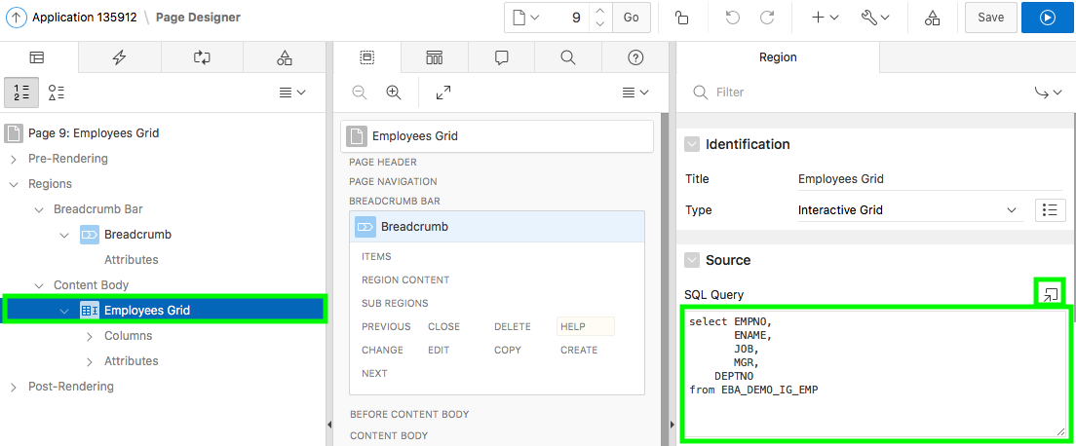
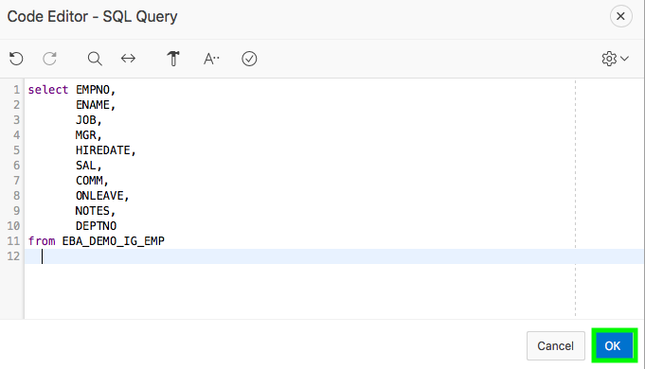
Modifying the SQL Source of an Interactive Grid
Notes:
You might want to make changes to the source query of your interactive grid. For example, you might want to add a new column to your interactive grid. To modify the SQL source of an interactive grid, perform the following steps:
In Page Designer, click on your interactive grid report region
In the Property Editor, expand Source > SQL Query.
Now, click the Code Editor icon to open the code editor dialog. Modify the query and click OK.
Click Save. Then, click Save and Run Page.
The slide example shows modifying the SQL source of an interactive grid. The new columns are added to the end of the report. However, in an interactive grid you can simply drag and drop columns to your desired location.

Slide 12

Part 2:Customizing an Interactive Grid as an End User
Notes:
In Part 2, you learn how to use and customize an interactive grid as an end user.

Slide 13
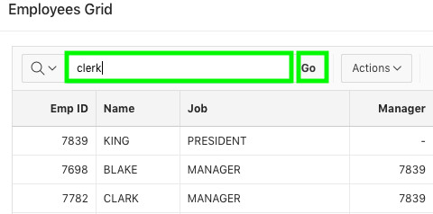
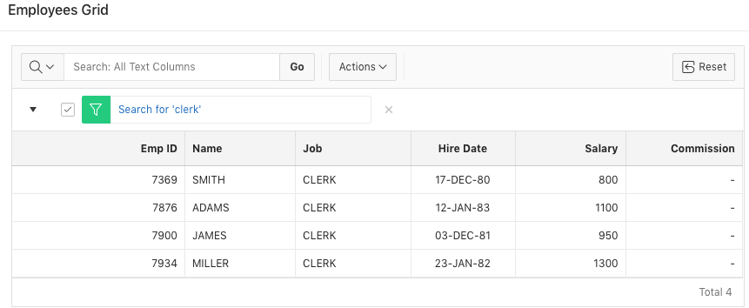
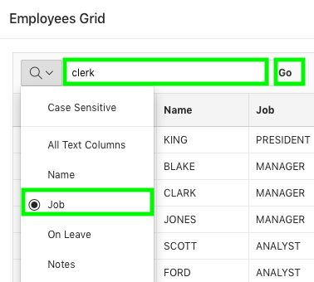
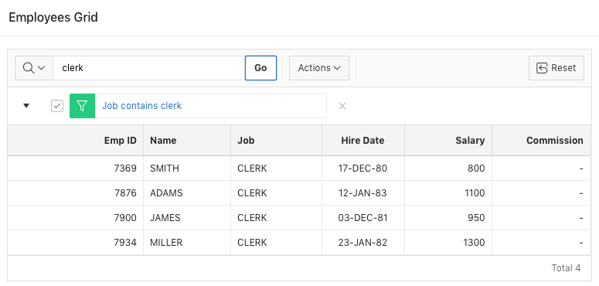
Searching in an Interactive Grid
Searching all text columns
Searching a specific column
Enable / disable filter
Remove filter
Notes:
A search bar displays at the top of interactive grids. Users can perform a non-case-sensitive on an interactive grid by entering queries into the search bar. You can search either on the entire interactive grid on only on a specific column.
The slide shows the examples of searching for the text ‘clerk’ both in the entire interactive grid and also specifically within the Job column. To search in the entire interactive grid, enter your search criteria in the text area and click Go. A filter is applied on the interactive grid and you see all those rows that contain the search criteria.
To narrow your search to a specific column, perform the following steps:
Click the Select Columns to Search icon
Select the name of a column. For example, ‘Job’ in the slide.
Enter a search string in the Search field. For example, ‘clerk’ in the slide
Press the Enter key or click Go. The interactive grid reloads with a filter applied.
You can create multiple filters on an interactive grid. For a row to be displayed, the row must satisfy all the filters.
You can remove a filter by clicking the Remove Filter icon (it looks like a filter with a red X over it) next to the filter that you want to remove. Alternatively, you can enable or disable the filter by using the Enable/Disable check box.

Slide 14
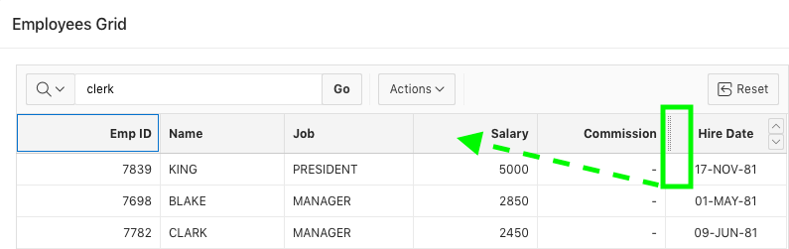
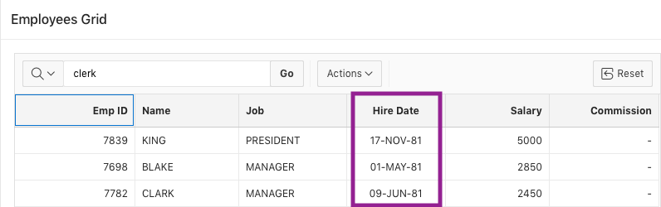
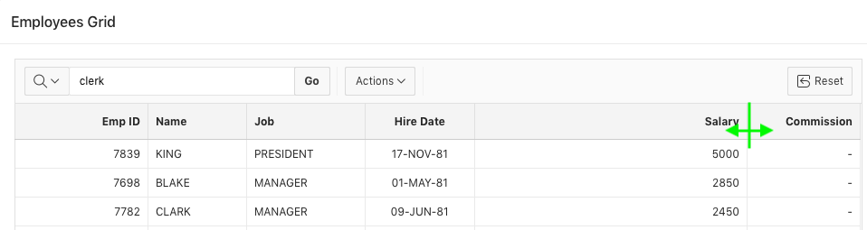
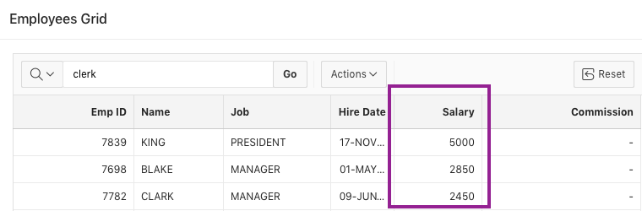
Rearranging and Resizing Columns
Rearranging columns by drag and drop
Resizing a column
Notes:
Interactive grid users can rearrange columns by using the drag and drop functionality. The slide shows an example of rearranging the Hire Date and Salary columns. To drag and drop a column, perform the following steps:
Hover the mouse over a column heading to display the drag handle. The slide example shows hovering the mouse over the Hire Date column.
Your mouse cursor also changes when it comes into contact with the drag handle. Click and hold the drag handle.
Then, drag the column to the desired location. The heading shifts out of place in the row. For example, in the slide, drag the Hire Date column to the Salary column location.
While holding the mouse, use the indicator to determine which column to place the dragged column ahead of. Release the mouse. The column drops into place.
Users can resize the width of a column by clicking and holding the edge of a column heading and adjusting with the mouse. The slide example shows
resizing the Salary column.

Slide 15
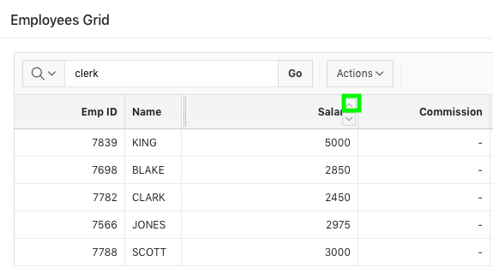
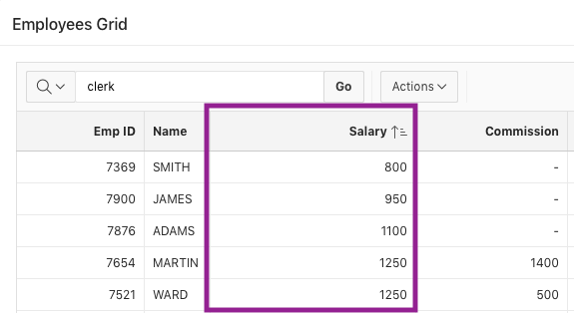
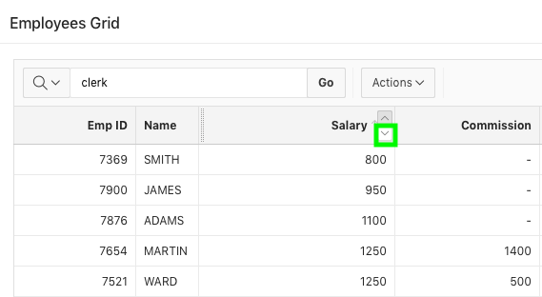
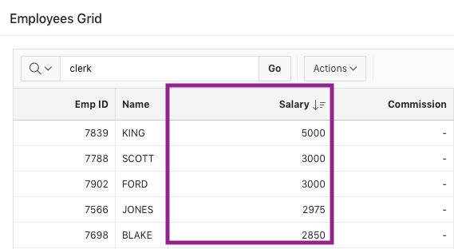
Sorting Columns in an Interactive Grid
Sort ascending
Sort descending
Notes:
Users can specify the sorting order of a column by clicking the Sort Ascending and Sort Descending buttons on the column heading. The slide examples show sorting both ascending and descending of the Salary column. To specify the sort order of a column, hover your mouse in the column heading. Select either Sort Ascending or Sort Descending. You can remove an existing sort by clicking the toggled button (Don’t Sort) again.

Slide 16
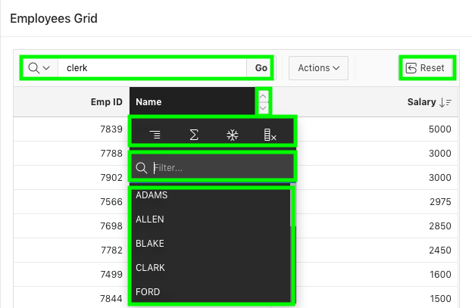
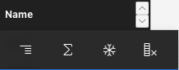
Using Interactive Grid Components: Column Heading Menu
Search Bar
Sort Order Buttons
Buttons toolbar
Text Filter
Control Break
Aggregate
Freeze
Hide
Unique list Of Column Content
Notes:
You use the interactive grid’s menus and interface to search the grid, add elements such as filters and computations, reorganize with sort and breaks, and
further customize how the data displays. With the Actions and Column Heading menus, users can hide, filter, freeze, highlight, sort, and create control
breaks on individual columns. Advanced users can also define aggregations, which appear at the bottom of the column or column group.
By default, all interactive grids have a Search Bar, Actions menu, and Reset button. You can perform text searches with the Search Bar at the top of an
interactive grid. You can narrow your search parameters by clicking the Select Columns to Search icon (magnifying glass).
All interactive grids also have Column Heading Menus. You click the name or heading of a column to access the Column Heading menu. You use the
Column Heading menu to quickly customize a column in an interactive grid. The Column Heading menu contains Sort Order buttons, a Toolbar, a Text
Filter, and a unique list of the column’s contents. The Sort Ascending and Sort Descending buttons appear at the right of every column heading. The
toolbar on the Column Heading menu contains the following buttons and functions:
Control Break: Creates a Control Break in the interactive grid based on the selected column.
Aggregate: Opens the Aggregation dialog to define an aggregation against the selected column.
Freeze: Freezes the selected column in place, preventing horizontal scrolling.
Hide: Hides the selected column from view.

Slide 17
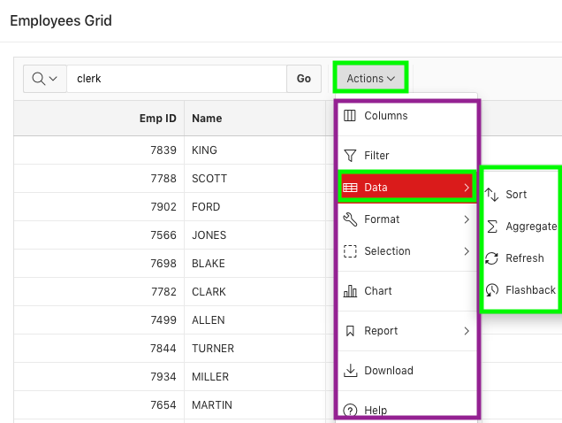
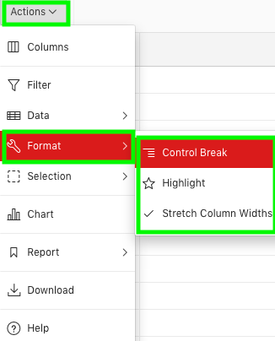
Using Interactive Grid Components: Actions Menu
Format Submenu
Data Submenu
Actions Menu
Notes:
The Actions Menu appears on the interactive grid toolbar. It contains functions and submenus for customizing and saving interactive grids.
Columns: Displays the Columns dialog. You toggle which individual columns are visible in the interactive grid, in what order they appear, and specify their display width (in pixels).
Filter: Displays the Filters dialog. You configure data filters to limit the rows returned.
Data: This submenu includes Sort, Aggregate, Refresh and Flashback functions
Format: This submenu includes Control Break and Highlight
Selection: This submenu includes Cell Selection and Copy to Clipboard
Chart: Displays the Chart dialog. Create a chart by selecting a chart type and configuring the required fields.
Report: This submenu includes Save, Save As, Edit, Delete, and Reset
Download: Displays the Download dialog. You download or email the interactive grid as a .csv or .html file.
Help: Launches a new window containing a summary of how to use interactive grids.
The Data submenu contains the following options:
Sort: Use the Sort dialog to change the columns to sort on and determine whether to sort in ascending or descending order.
Aggregate: Use this dialog to perform mathematical computations against a column.
Refresh: Click Refresh to repopulates the interactive grid with the most current data from the database.
Flashback: Use this dialog to reload the data as it existed at a previous point in time.
The slide shows a read only interactive grid. For an editable interactive grid, you see additional submenus under Selection.

Slide 18
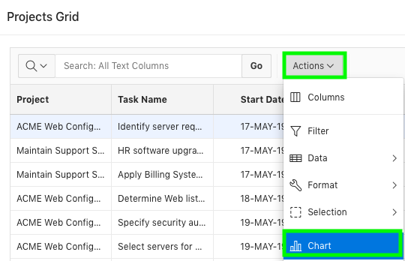
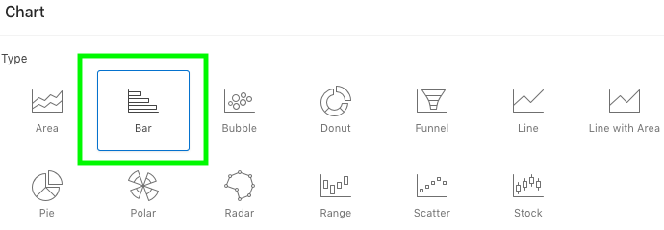
Using Charts in an Interactive Grid
1
2
Notes:
The slide shows an example of creating a bar chart in an interactive grid. To create a chart, you select Chart from the Actions menu and then configure
the required fields.
To create a chart in an interactive grid, perform the following steps:
Click the Actions menu and select Chart. The Chart dialog appears.
Select a chart type. In the slide example, you select Bar for chart type. The dialog populates with options specific to the selected chart type. For example, a bar chart has a different set of configuration fields than a pie chart. Select different types to see the range of available options.

Slide 19
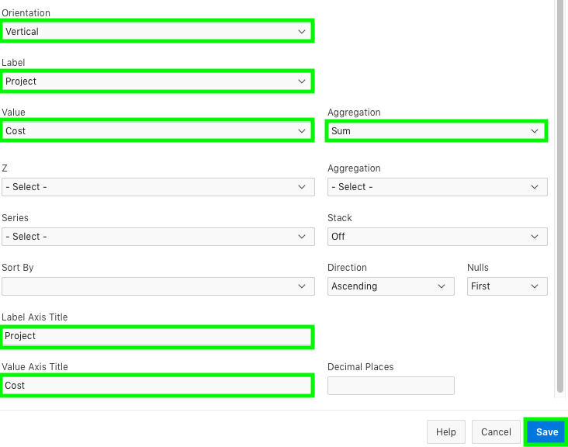
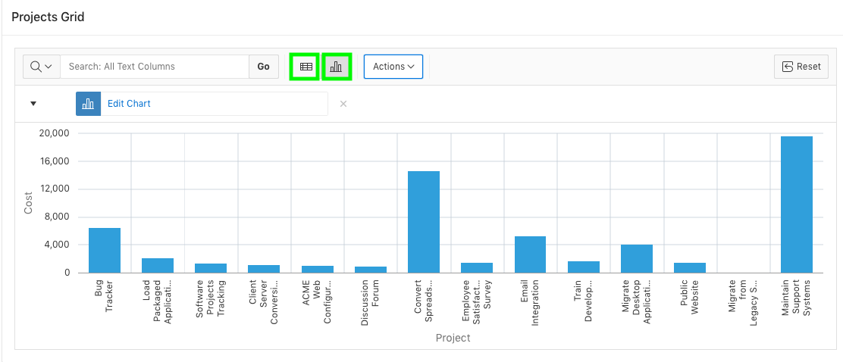
Using Charts in an Interactive Grid
3
Chart View
Notes:
Configure the chart settings. For example, the following is a configuration for a Bar chart:
Orientation : Select Vertical for the bars to increase toward the top of the chart, or Horizontal to increase toward the right.
Label: Select the column to be used as the Label (the label appears beneath or beside the bar).
Value: Select the column to be used as the Value (the value is the quantity that determines the size of the bar).
Aggregation (Optional): Select an additional aggregation to be performed on the column selected for the Value. Valid selections include: Count, Count Distinct, Minimum, Maximum, Sum, or Average.
Click Save.
The slide example shows a bar chart of project budgets with a sum aggregation.
Once a chart is created, you can switch the view between Grid and Chart by clicking the toggle that appears on the top of the
interactive grid. To reconfigure the chart, click the Edit Chart filter. To remove a chart, click the Remove Chart icon (X) adjacent to the chart filter.
You can only create one chart at a time in an interactive grid. To create a second chart, reconfigure the existing chart by clicking Edit Chart, or delete it.
You learn more about charts in the Adding Additional Pages to your Application lesson.

Slide 20
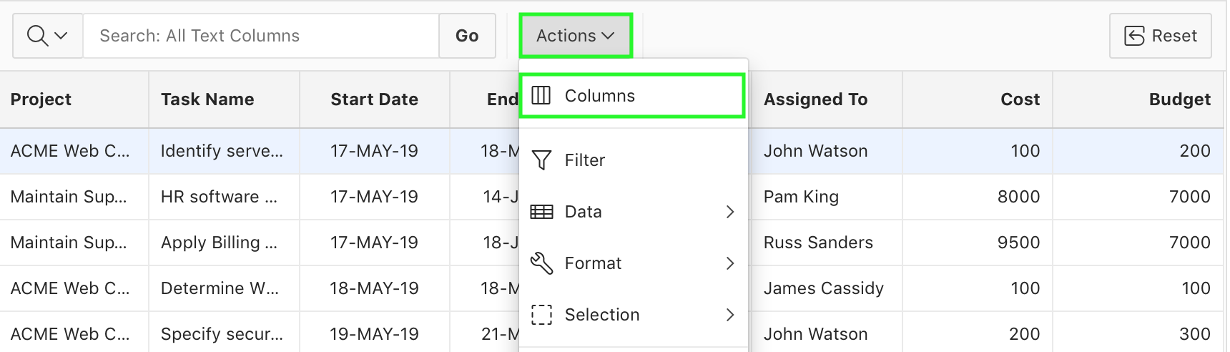
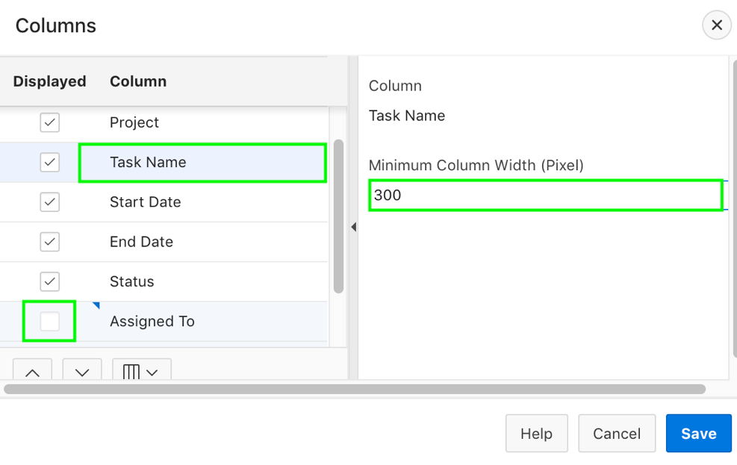
Changing the Column Display in an Interactive Grid
1
2
Notes:
The slide shows Projects interactive grid and you want to adjust the column display. You do not want to display the Assigned
To column and increase the width of Task Name. You want to move the Start Date and End Date columns to be displayed
after the Budget column.
To edit how columns display in an interactive grid, perform the following steps:
Click the Actions menu and select Columns. The Columns dialog displays.
For Displayed, select the check box to show a column in the grid; deselect a check box to hide a column in the grid. For Minimum Column Width (Pixel), adjust the displayed numeric value to widen or narrow the column (for example, a higher number widens the column).
In the slide example, you deselect the Assigned To column, and specify 300 as minimum column width for Task Name.

Slide 21
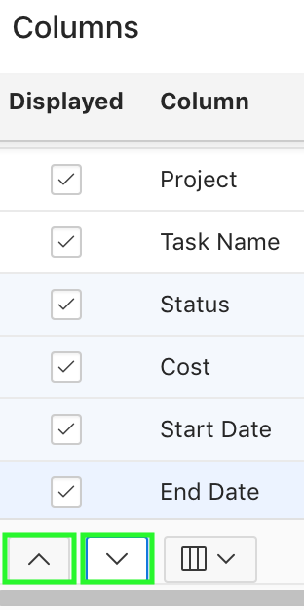
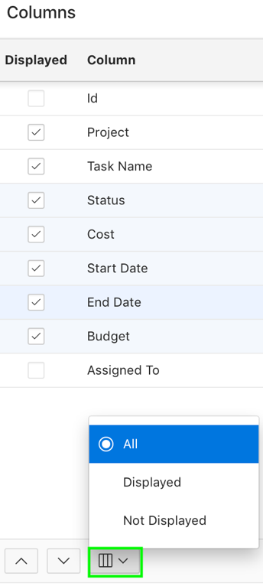
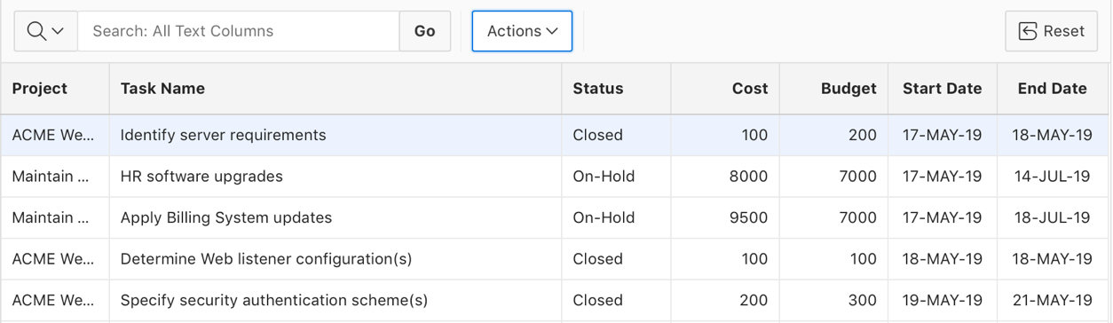
Changing the Column Display in an Interactive Grid
3
4
Adjusting the column display order
Toggling the columns button
Notes:
Adjust the order in which a column appears in the grid by selecting Move Up or Move Down.
Toggle the Columns button and the list displays All, Displayed, or Not Displayed (hidden) columns. Specify your choice. Click Save.
In the slide example, you use the Move Down arrow to change the display order of Start Date and End Date columns
so that they appear at the end in the interactive grid.
The slide shows how the Projects interactive grid looks like after adjusting the column display:
Assigned To column is no longer displayed
Width of Task Name is now increased
Start Date and End Date columns appear towards the end

Slide 22
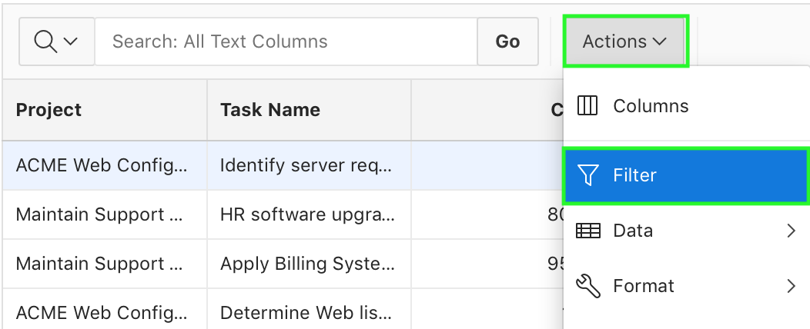
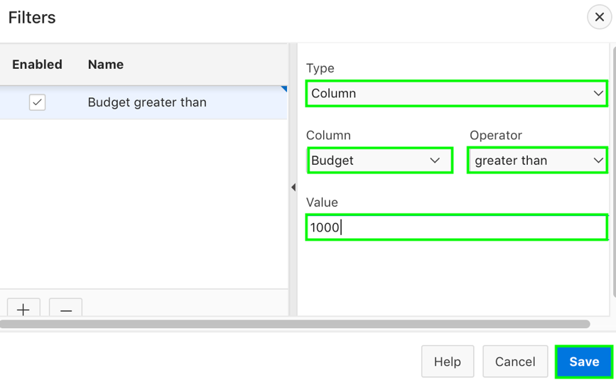
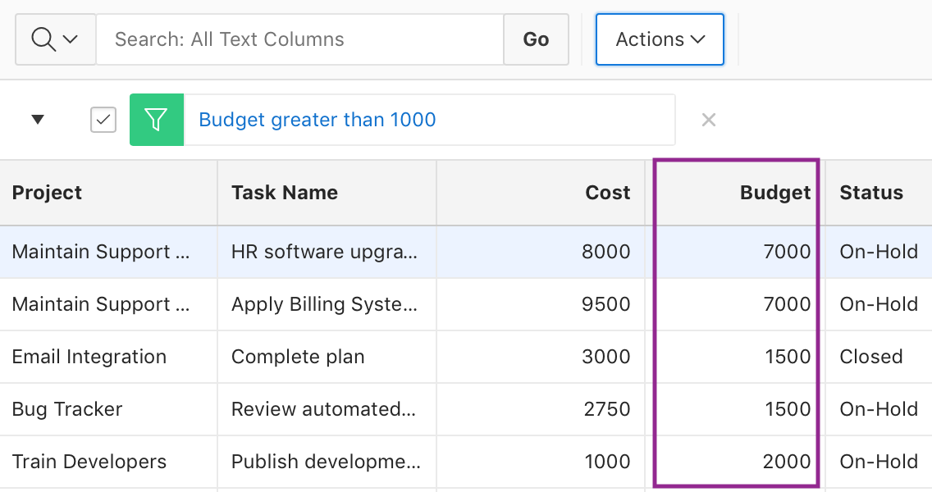
Creating a Column Filter
1
2
Projects with budget greater than 1000 are displayed
Notes:
The slide example shows a column filter applied on the Budget column to display the projects with budget greater than 1000.
End users can narrow the contents of an interactive grid by applying a filter to it. Once applied, filters can be temporarily enabled or disabled or removed permanently directly in the interactive grid. You can also click the filter name for quick reconfiguration.
Existing filters display between the search bar and the grid. Rather than deleting a filter, you can disable it by deselecting the adjacent checkbox. You can leave a filter disabled and save your report to preserve it for future usage. To edit a filter, you can click its name or open the Filters dialog and select it in the list. You can permanently remove a filter by clicking the adjacent Remove Filter icon (X).
Filter a column in an interactive grid with a specified operator and value.
To add a filter to a column in an interactive grid, perform the following steps:
Click the Actions menu. Select Filter. The Filters dialog displays.
In the Filters dialog:
Type - Select Column.
Column - Choose the column to filter. For example, in the slide, select Budget.
Operator - Choose the filter logic. In the slide, select greater than.
Value - Enter the filter criterion. In the slide, enter 1000.
Click Save. The filter is added to the grid.

Slide 23
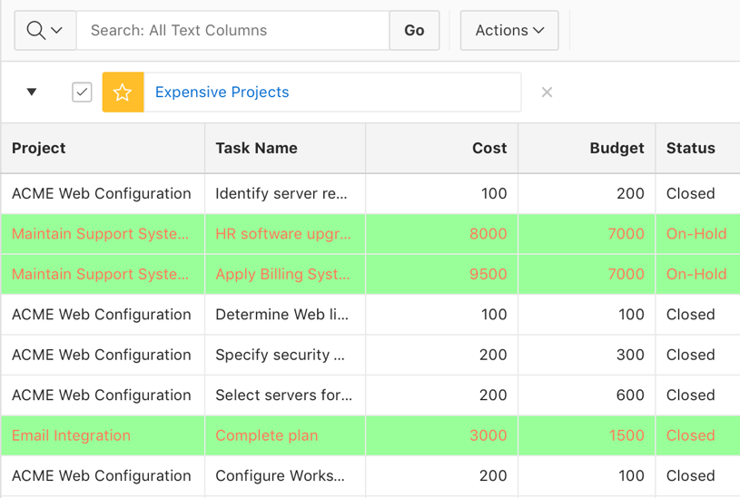
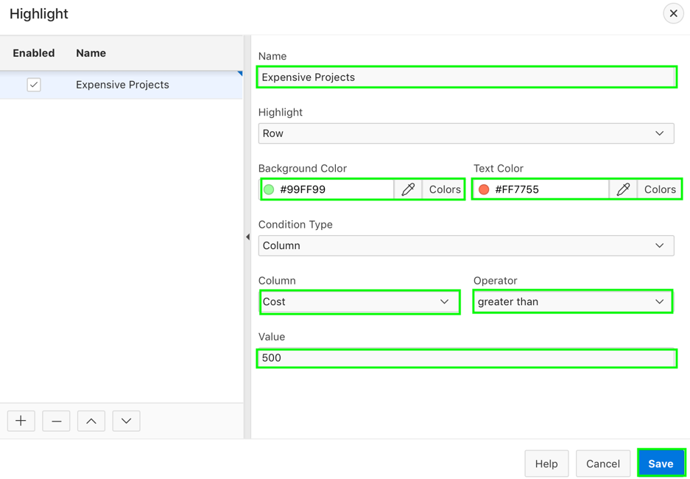
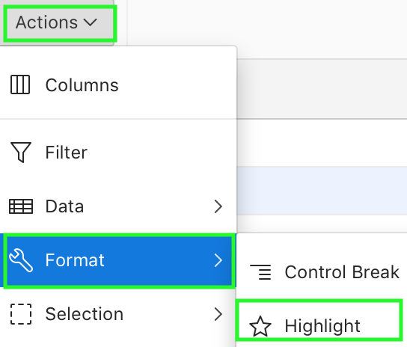
Adding Highlighting to an Interactive Grid
2
1
Rows with project cost greater than 500 are highlighted
Notes:
The slide example shows Expensive Projects filter above the interactive grid. You see that the rows with Cost column values greater than 500 are highlighted with the text color in red and background color in green. This example shows how to apply conditional highlighting in an interactive grid. End users can apply color effects to an interactive grid by selecting Highlight in the Actions, Format submenu. To highlight an interactive grid cell, perform the following steps:
Click Actions and select Format then Highlight. The Highlight dialog displays.
In the Highlight dialog:
Name: Enter the name of the highlight (this name displays as a filter above the interactive grid). For example, in the slide, enter Expensive Projects.
Highlight: Choose the Row or Column to apply the highlight. In the slide example, you accept the default – Row.
Background Color: Select the color of the background in a highlighted cell. Choose a specific RGB value or a basic color from a list of presets.
Text Color: Select the color of the text in a highlighted cell. Choose a specific RGB value or a basic color from a list of presets.
(Optional) In the Highlight dialog, configure advanced highlighting conditions. For example, to conditionally highlight all rows with the project cost greater than 500,
Column: Select Cost.
Operator: Select greater than.
Value: Click the arrow to display the drop-down list of valid values and select 500 from the drop-down list.
To add an additional highlight, click the Add icon (+); click the Delete icon (—) to remove an existing highlight.
Click Save.

Slide 24
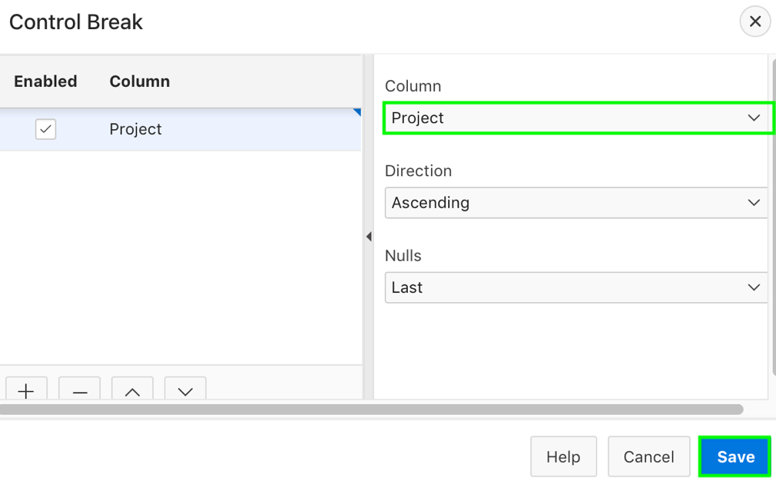
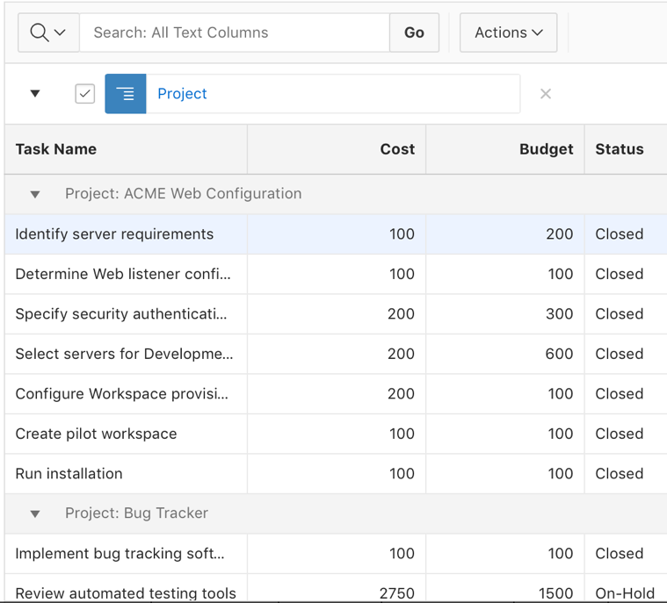
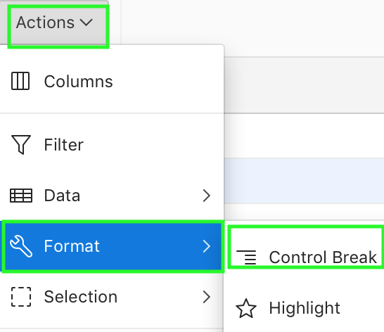
Creating a Control Break in an Interactive Grid
2
Control break on projects
1
Notes:
The slide example shows a control break applied to the interactive grid for the Project column. End users can break an interactive grid (that is, compartmentalize the layout) by column by selecting Control Break in the Actions, Format submenu. Creating a break group pulls the columns out of the interactive grid and displays them as a master record.
To create a control break, perform the following steps:
Click the Actions menu and select Format then Control Break. The Control Break dialog displays.
In the Control Break dialog, specify the following and click Save:
Column - Select the name of the column. For example, in the slide, select Project.
Direction - Select the sort direction (Ascending or Descending).
Nulls - Select the null sorting behavior (First or Last)
The interactive grid reloads with the control break applied for the selected column, and a control break filter appears above the grid near the toolbar. To edit a control break, click the name to display the Control Break dialog. You can also add, edit, and delete other control breaks in the Control Break dialog.
To remove a control break, click the Remove Control Break icon (X) on the control break filter.

Slide 25



Saving your Customized Interactive Grid as a Report
Interactive grid saved as a private report
Notes:
The slide shows saving an interactive grid as a private report named Project Break-up. End users save changes made to their interactive grid as a new report within the application. End users can name and keep these interactive grid reports Private or make them Public to share with other users.
Reports in interactive grids have varying uses and characteristics. End users interact with the Primary report of an interactive grid, and save their changes as Private reports. The default state of an interactive grid is the Primary report. While users can customize the look and organization of a Primary report, they cannot overwrite or rename it. The Primary report is useful as a backup or a starting point for customizing new views of the interactive grid. Once you save a private report, a drop-down list appears on the toolbar near the Search bar. You can use this to select between reports.
To save an interactive grid as a private report, perform the following steps:
Click the Actions menu and select Report then Save As. The Save As dialog displays.
In the Save As dialog:
Type - Select Private.
Name - Enter a name for the grid.
Click Save.
Save further changes to the report by selecting Save in the Actions, Report submenu. The report is saved and a confirmation message displays.

Slide 26



Downloading or Emailing an Interactive Grid
1
2
Report sent as Email attachment
Notes:
The slide shows sending an interactive grid as a CSV attachment in Email. End users can obtain the data of an interactive grid as a CSV or HTML file by selecting Download in the Actions menu.
Perform the following steps:
Click the Actions menu and select Download. The Download dialog displays.
Select CSV or HTML. Do one of the following:
To download the file, click OK. Your browser downloads the file.
To email the file, select the check box for Send as Email. Perform the following steps:
Complete the fields for the recipients (Address, Subject, Message).
Click Send as Email. The file is sent as an attachment to the email.

Slide 27

Refreshing an Interactive Grid
Update an interactive grid with the most current data available on the database
Notes:
You can update an interactive grid with the most current data available on the database by selecting Refresh in the Actions, Data submenu. Refreshing an interactive grid is quicker than reloading the entire page in the browser. Refreshing is also a valuable feature for highly fluid data sets.
To refresh an interactive grid:
Click the Actions menu and select Data.
Select Refresh. The grid refreshes. Updates to the data are applied, but not marked.

Slide 28



Reversing an Interactive Grid to a Previous State
1
2
Notes:
End users can revert an interactive grid to a specific point in time by selecting the Flashback in the Actions, Data submenu.
To revert an interactive grid to a previous state, perform the following steps:
Click the Actions menu, select Data, and select Flashback. The Flashback dialog displays.
Enter the number of minutes into the past that you wish to return to. For example, in the slide, you enter 5.
Click Save. The grid reloads.

Slide 29
Summary
In this lesson, you learned how to:
Manage interactive grid attributes
Control Interactive Grid Pagination
Customize the Interactive Grid Toolbar
Enable Users to Save Public Interactive Grids
Customize interactive grid as an end user

Slide 30


Slide 31
Hands-on Lab

